Slide 1

Managing ocean pollution from rivers
T-226

Slide 2
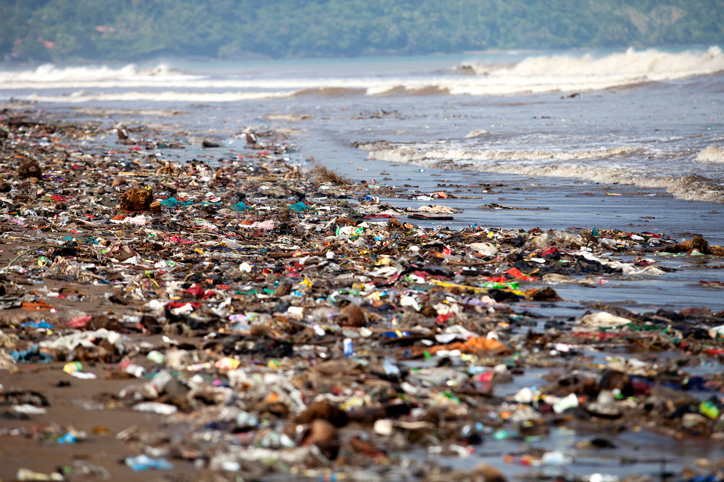
The Problem Statement
The marine has it hard with all the pollution in the oceans which in turn enter the sea mostly via the polluted waters from rivers.
This is a pretty large scale problem in India as there are about 400 rivers in India. So it only makes sense that there are 400 such junctions that meet the seas.
The cause of the ocean pollution is simple.
Letting the Untreated water into the ocean.

Slide 3
Our Plans
Making an organisation that focus on raising funds for the future of the plan.
The sewer system
The Smelter
The River filtration system

Slide 4
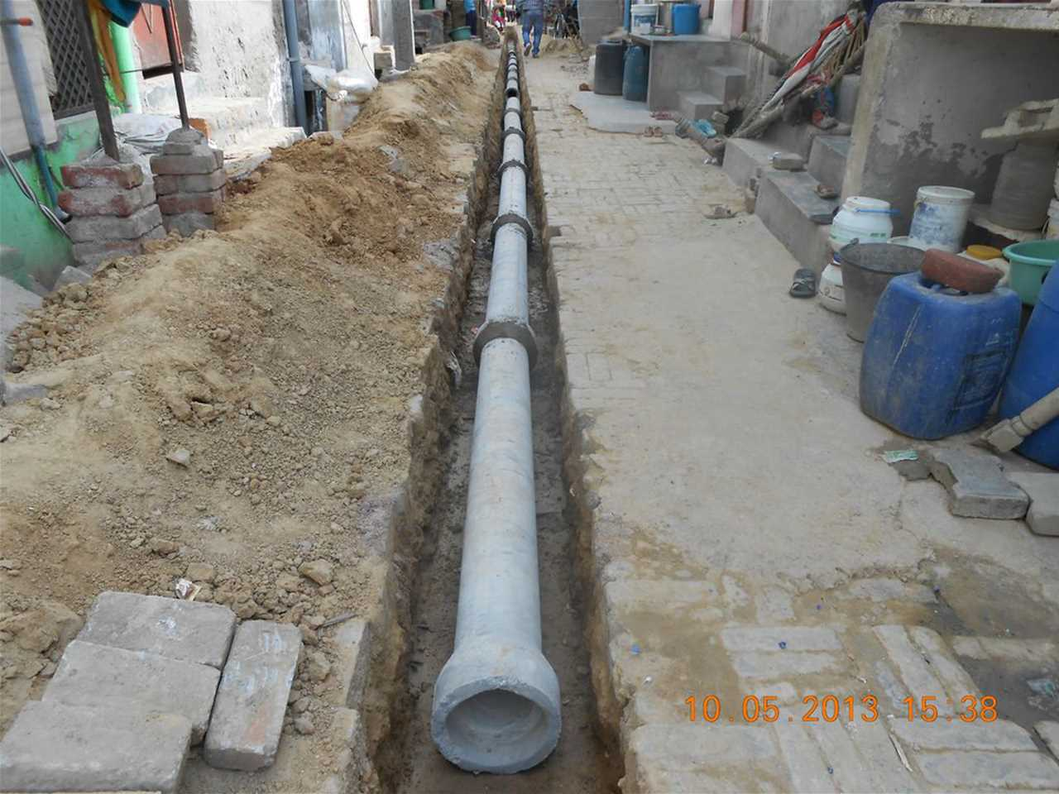
The Sewer system
Read the map of the sewer lines
Place check points to mark filtration sites
Have it set up and then have workers manually get rid of the trash.
Rechannel the purified water back to waterbodies.
May choose to make it automatic later on.

Slide 5
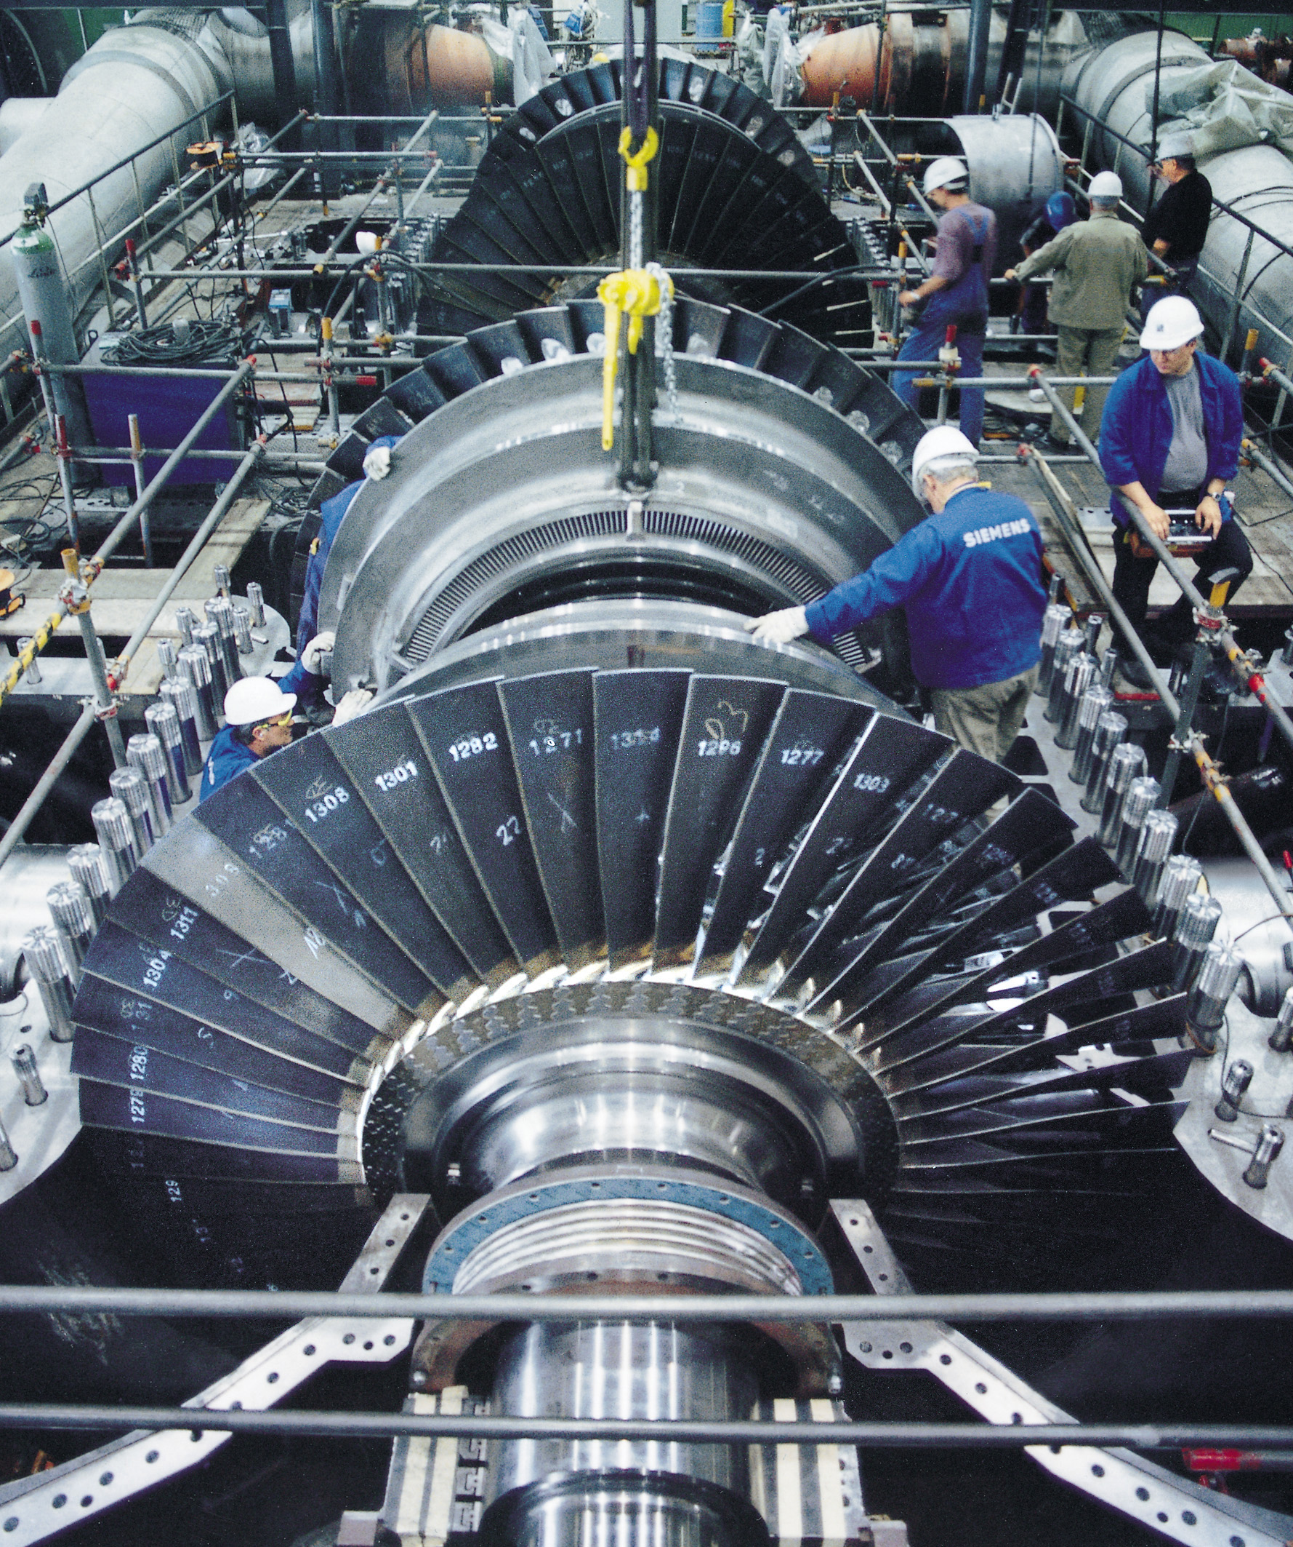
The Smelter plan
This is a very important set up because the garbage collected will then be taken in to have huge reserves of energy created.
The re-cyclable plastic will be separated out and will be
sent for recycling.
This energy is then converted to electricity by rotating
turbines.
These turbines will rotate due to the steam produced.

Slide 6
The River Filtration system plan
The rivers will have basic chemical Filters at their last dam.
Many Mini sites of Water channelers will be placed along the banks of the river.
These will channel the water into filtration processes to have all the debris removed and have it safely rechanneled it back to the waters.
These motors will get their electricity from the turbines earlier.

Slide 7
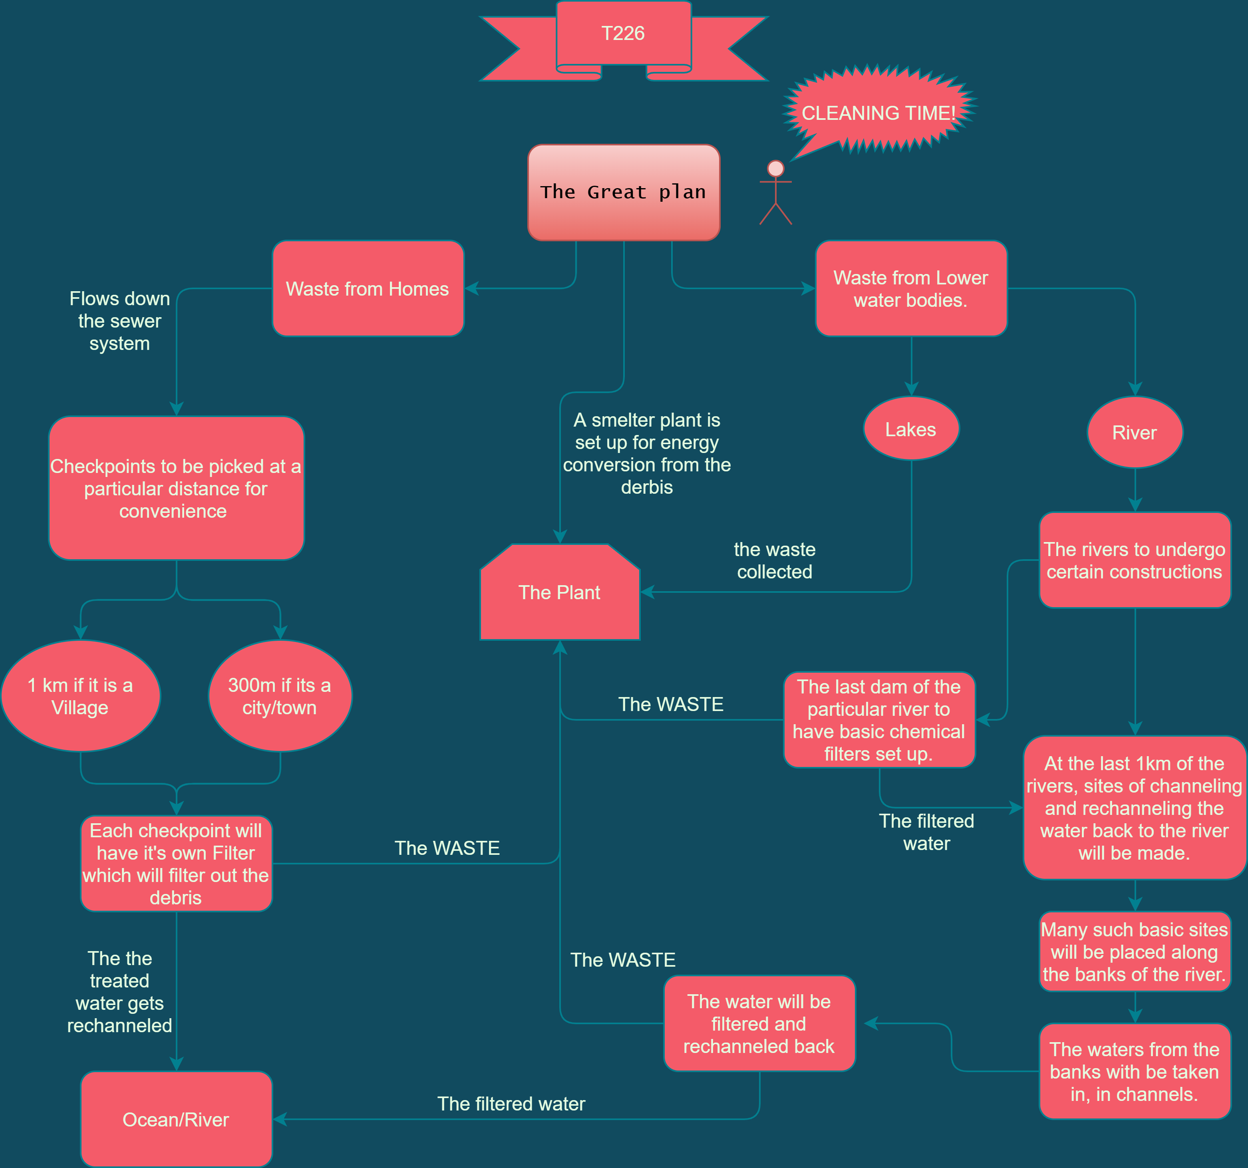
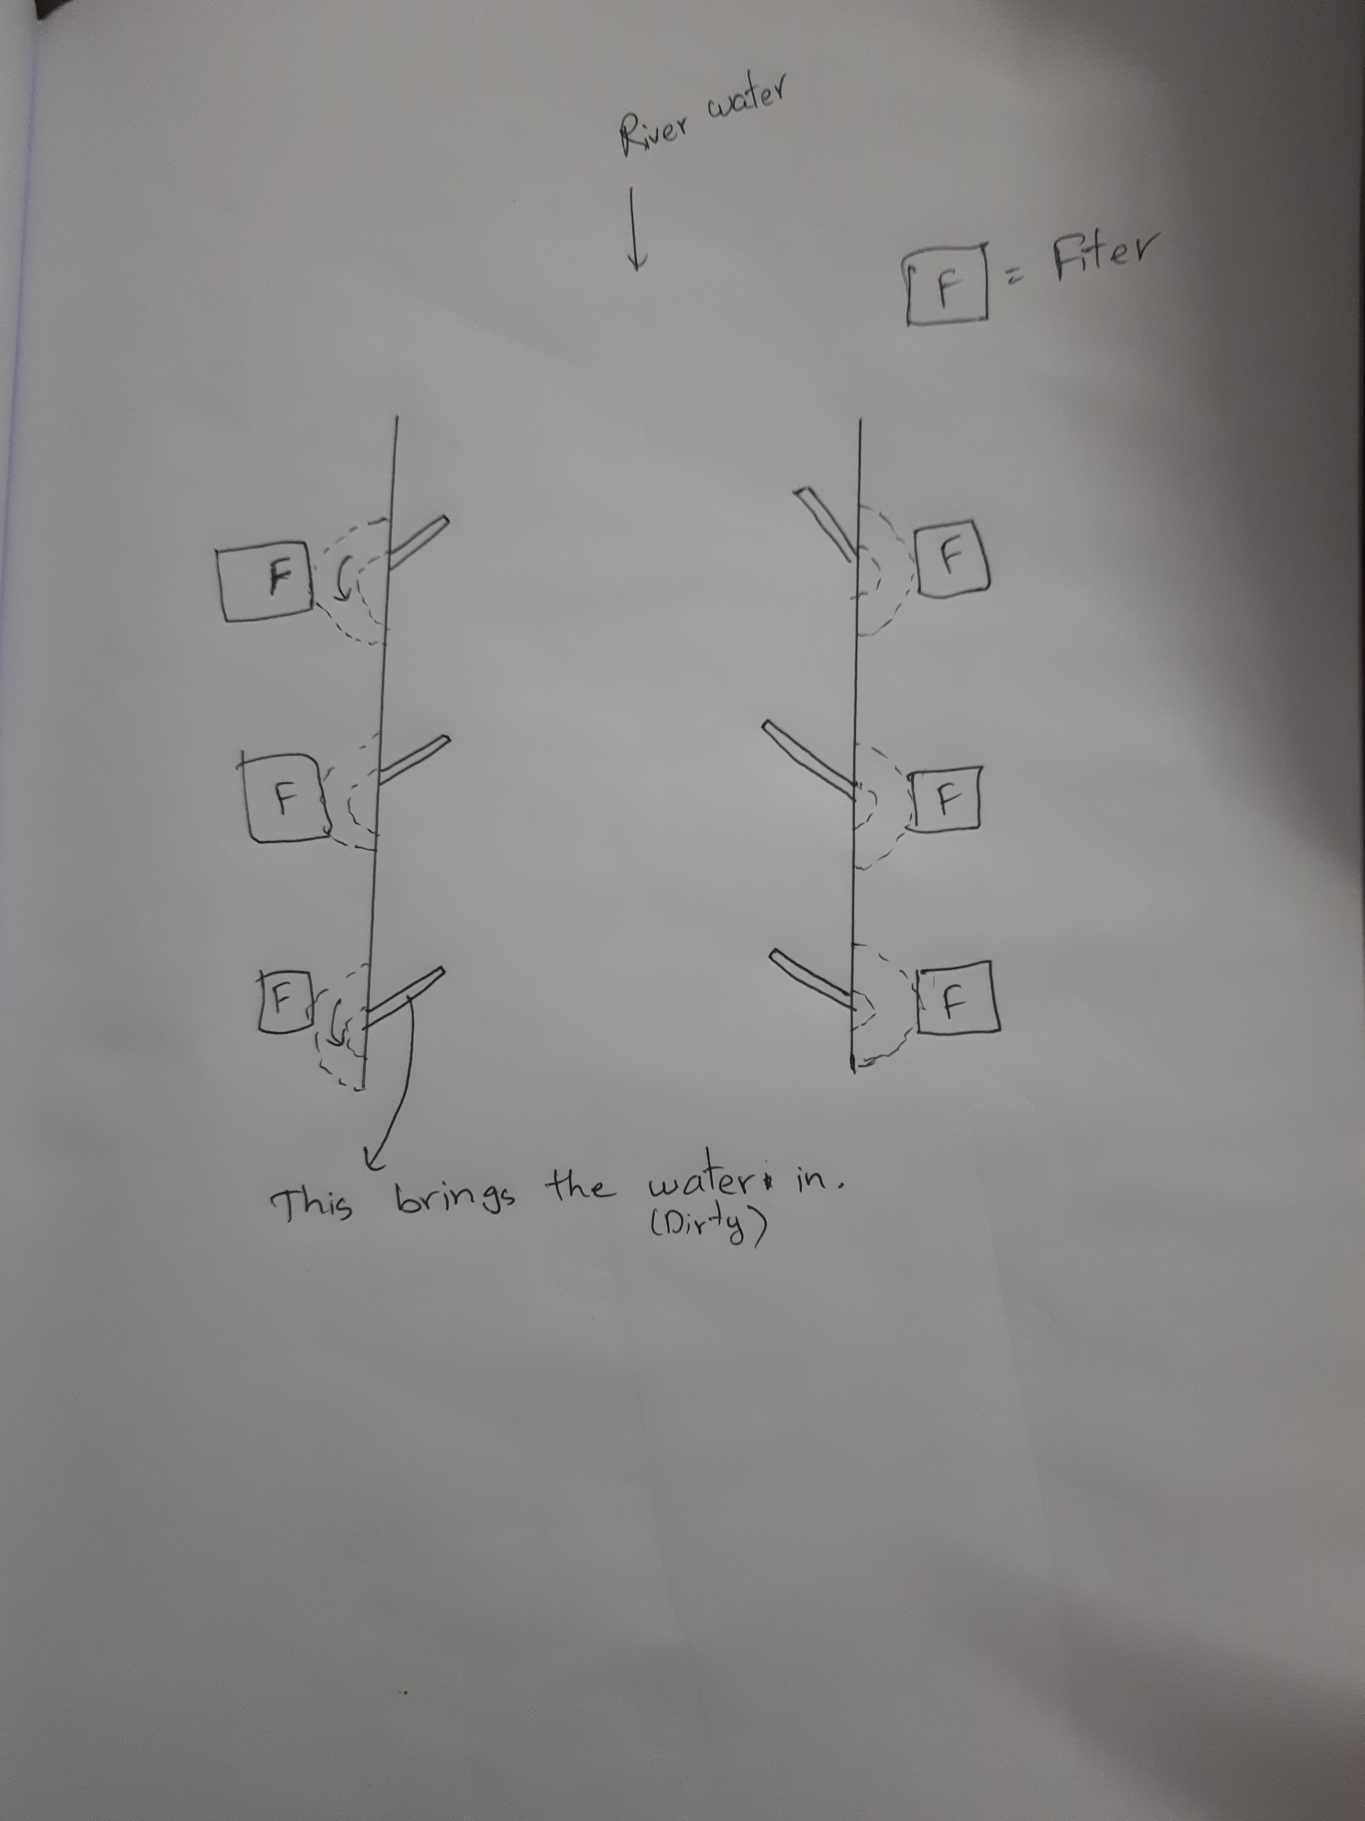
The mindmap to the plans The river system

Slide 8
The Benefits
The Filtrations at earlier parts of the river wont be required.
This is like a proper defence mechanism if seen properly…Because the shores where the rivers meet will have the filtration processes done.
This plan focuses more on Making sure trash from rivers don’t meet the oceans.

Slide 9
How to get the funds
First off the permissions from certain state governments will be required.
Organising Awareness events.
Online donations trough a website
Funding from International funding agencies.

Slide 10
Thank You
Hope you like the idea

